Slide 1
COMPUTATIONAL DRUG DESIGN
Dr Sadaf Naeem

Slide 2
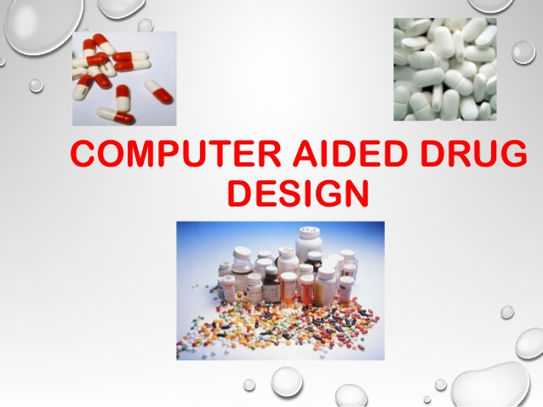

Slide 3
THE DISCOVERY PROCESS
Drug discovery is a very long and expensive procedure
It takes approx 10-15 years to develop one new drug
The average cost is $800 million to $1 billion.
For every 5,000- 10,000 compounds that enter the research and development (R&D) pipeline, ultimately only one receives approval.
Notes:
The discovery process includes all early research to identify a new drug candidate and testing it in the lab. The process takes approximately 3-6 years. by the end, researchers hope to have a promising candidate drug to test in people.

Slide 4
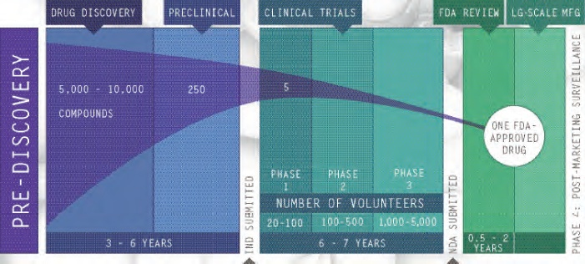
Notes:
IND Investigational new drug
The U.S. Food and Drug Administration (FDA)

Slide 5
Pre-discovery
Understand the disease
Choose a target molecule
Drug Discovery
Lead Identification
Find a promising molecule (a “lead compound”) that could become a drug
Lead compound could be a natural product or a synthetic compound
Can be identified by High Throughput Screening where hundreds of thousands of compounds are tested against a target.
Based on the results, several lead compounds are usually selected for further study.

Slide 6
Early Safety Tests
Perform initial tests on promising compounds
Calculate “Pharmacokinetics,” or ADME/Tox properties (Absorption, Distribution, Metabolism, Excretion and Toxicological) of each lead.
Successful drugs must be:
• absorbed into the bloodstream,
• distributed to the proper site of action in the body,
• metabolized efficiently and effectively,
• successfully excreted from the body and
• demonstrated to be not toxic.
Notes:
Lead compounds go through a series of tests to provide an early assessment of the safety of the lead compound.
Scientists test

Slide 7
Lead Optimization
Alter the structure of lead candidates to improve properties.
Preclinical Testing
In-vitro (lab; test tube) and in-vivo ( animal model) testing, to determine if the drug is safe enough for human testing.
After starting with approximately 5,000 to 10,000 compounds, one and five molecules are selected as “candidate drugs,” which then be studied in clinical trials.
Notes:
Lead compounds that survive the initial screening are then “optimized,” or altered to make them more effective and safer. By changing the structure of a compound, scientists can give it different properties. For example, they can make it less likely to interact with other chemical pathways in the body, thus reducing the potential for side effects.

Slide 8
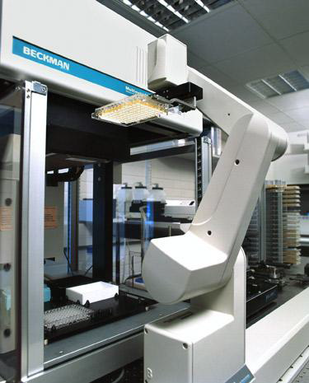
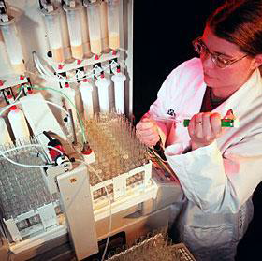
High throughput automation
High-throughput screening Combinatorial chemistry
Still need to consider carefully what to screen/make

Slide 9
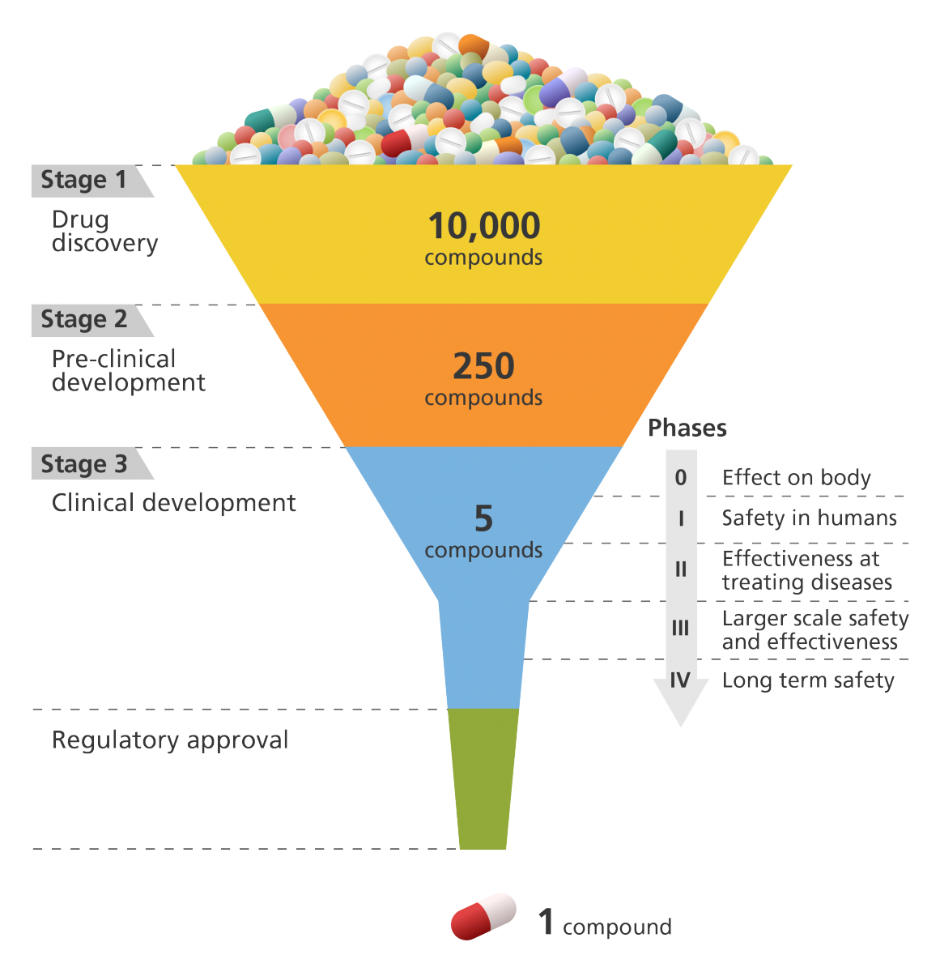

Slide 10
Strategies for Drug Discovery
Time consuming and costly
Experimental-based High Throughput Screening
Virtual Screening
Notes:
As discussed earlier this drug discovery is a long and costly method ….where thousands of compounds tested against a target in the lab….to reduce the time and cost compunds can be screened by using compouters…that’s is virtual screening

Slide 11
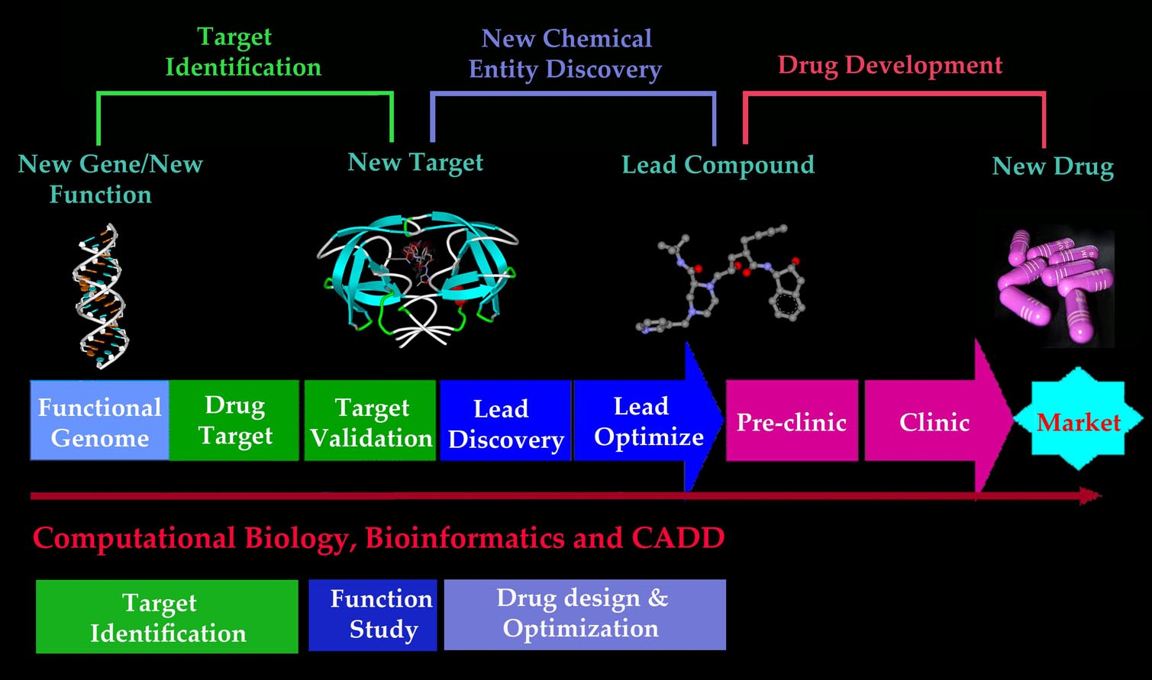

Slide 12
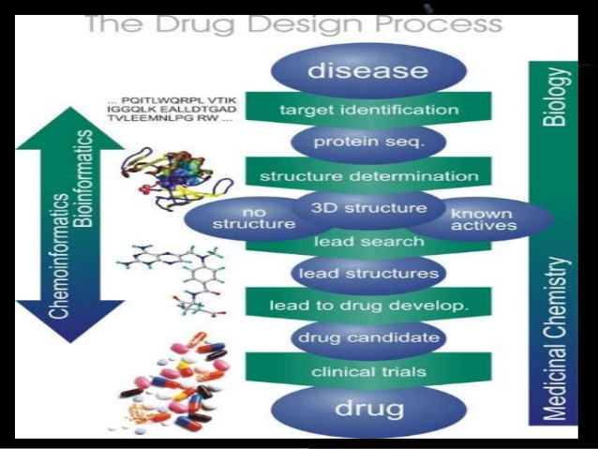

Slide 13

Drug discovery in the 21st Century
in vitro in silico + in vitro
Diverse set of molecules tested in the lab
Computational methods to select subsets (to be tested in the lab) based on prediction of drug-likeness, solubility, binding, pharmacokinetics, toxicity, side effects, ...
Notes:
In silico results can be used to make in vivo methods more efficient. If there are several thousand compounds available for testing, in silico methods are used to identify those that are most likely to be active and these would take priority for screening.

Slide 14
Virtual Screening
Virtual screening (VS) is a computer-based technology to analyse large
database of chemicals in order to search for novel lead compounds.
In general, VS identify drug candidates through database searching.

Slide 15
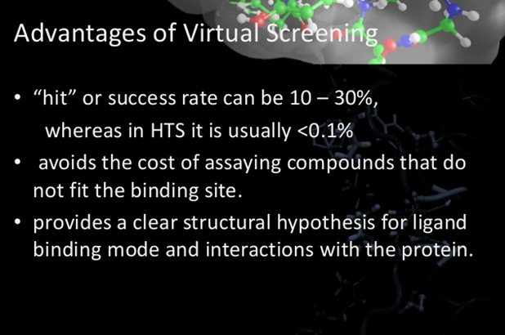

Slide 16
Virtual Screening
Target Disease
Target Protein
Database of compounds
Virtual Screening of compounds
In Vitro Assays
Generic overview of the virtual screening process

Slide 17
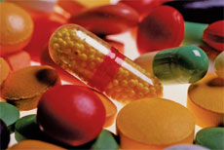
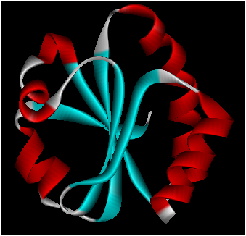

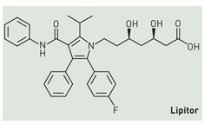
Drug Design & Discovery
Drugs:
Targets:
Natural sources
Synthetic sources

Slide 18
Databases
There are various natural product or synthetic compounds Databases are available.
Some of them are:

Slide 19
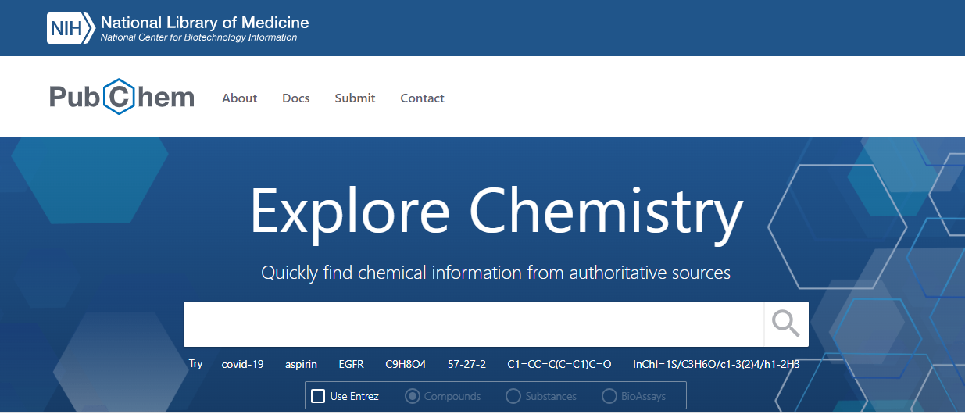

Slide 20
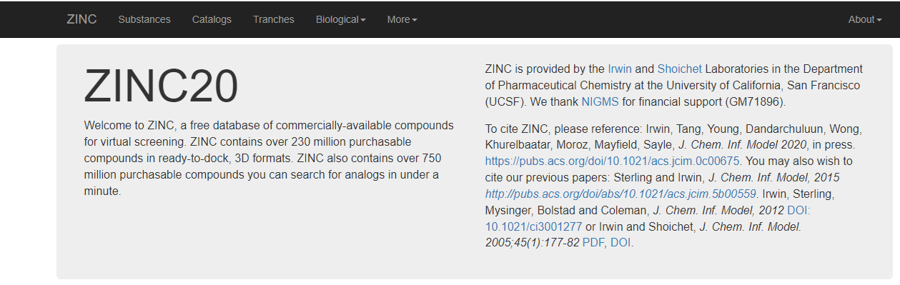

Slide 21
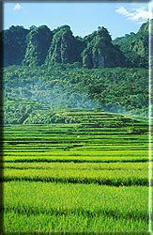
Natural Products as Drugs
Plants have been utilized as medicine for thousand of years
Approx. 80% of the world’s people rely on herbs for their primary health care need
Approximately 49%-61% of NCE’s launched between 1981-2002 were natural product or natural product derived drugs

Slide 22
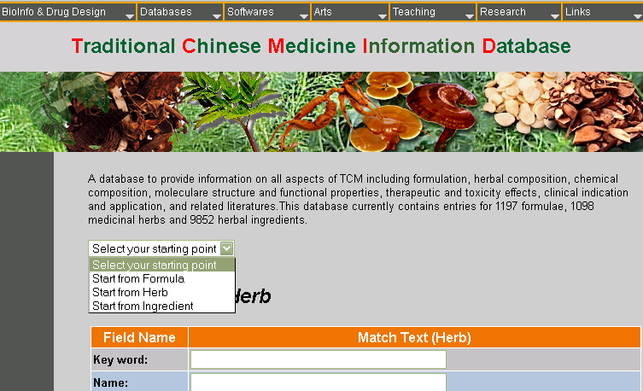

Slide 23
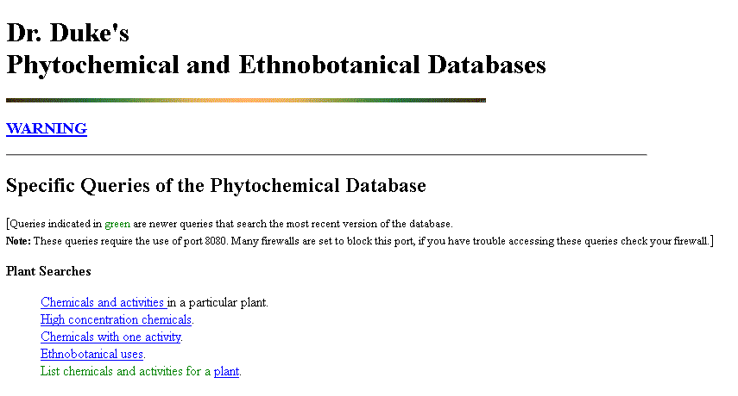

Slide 24
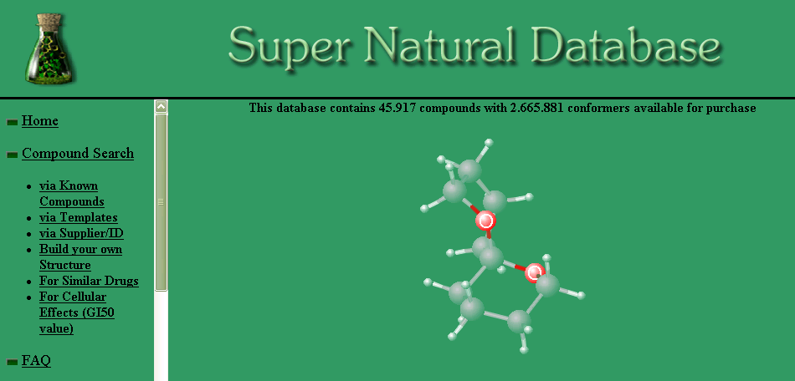

Slide 25
All of these databases have their own limitations; some lack structural information and others lack herbal details.

Slide 26
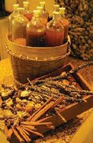
Indonesian Herbal Medicine
Traditional Herbal Medicine still play an important role in the treatment of illness in Indonesia
more than 1300 species are known as medicinal plants called “Jamu”.
As the biological activity of jamu is largely based on empirical data, more research is needed scientifically prove efficacy and to ensure safety

Slide 27
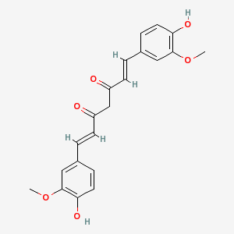
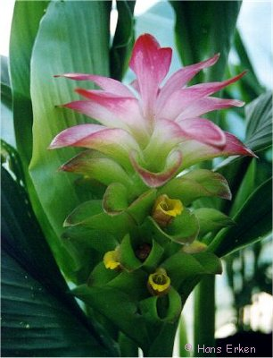
Indonesian Herbal constituents Database (IHD)
The IHD currently contains details on more then 1,500 compounds found in 36 commonly used herbs.
Specie: Curcuma xanthorrhiza
Compound : Curcumin
Structure:
Synonyms: Diferuloylmethane, Turmeric Yellow Systematic name: (1E,6E)-1,7-bis(4-hydroxy-3-methoxyphenyl) hepta-1,6-diene-3,5-dione
Molecular weight: 368.3799
Biological Activities: 1)12-Lipoxygenase Inhibitor 2)5-Alpha ReductaseInhibitor 3)5-Lipoxygenase Inhibitor 4)AntiHIV 5)Antiviral 6)Cytochrome P450 Inhibitor 7) Topoisomerase I & II Inhibitor 8) Protease Inhibitor
IC₅₀ Values: 4)IC50=40μM 5)IC50=54μM 8)IC50=11-250μM
Toxicity(LD50): a)2000mg/kg (mouse,oral)
CAS NO.: 458-37-7
Part of Plant: Rhizome
Reference: 9) Pizzorno, J. 1998. Total Wellness. Prima Health, a division of Prima.

Slide 28
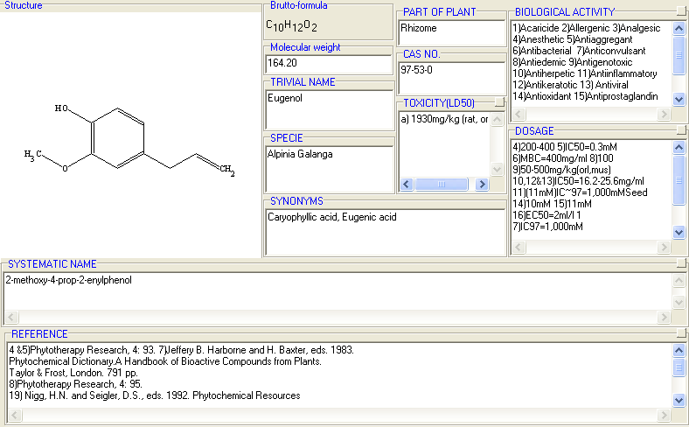
This database was constructed using “ChemDBSoft” software

Slide 29
Virtual (In-silico) Screening
Virtual screening is an important component of computer based search for novel lead compounds.
In general VS identify drug candidates through database searching.
The principal requirement for virtual screening (VS) is a knowledge of the spatial and energetic criteria responsible for the binding of a particular candidate ligand to the chosen receptor target.
For this purpose either the 3D structure of the macromolecular target or at least a rigid reference ligand with a known bioactivity must be available.

Slide 30
There are two classes of VS:
Ligand-Based Virtual Screening (LBVS)
2) Structure-Based Virtual Screening (SBVS)

Slide 31
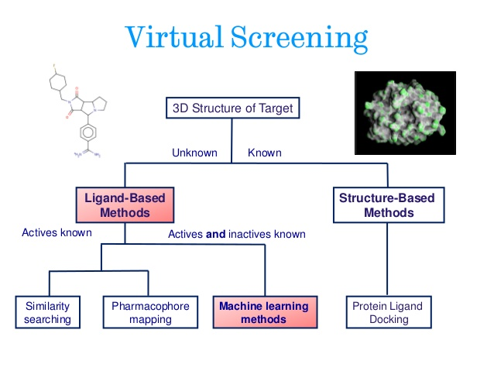

Slide 32
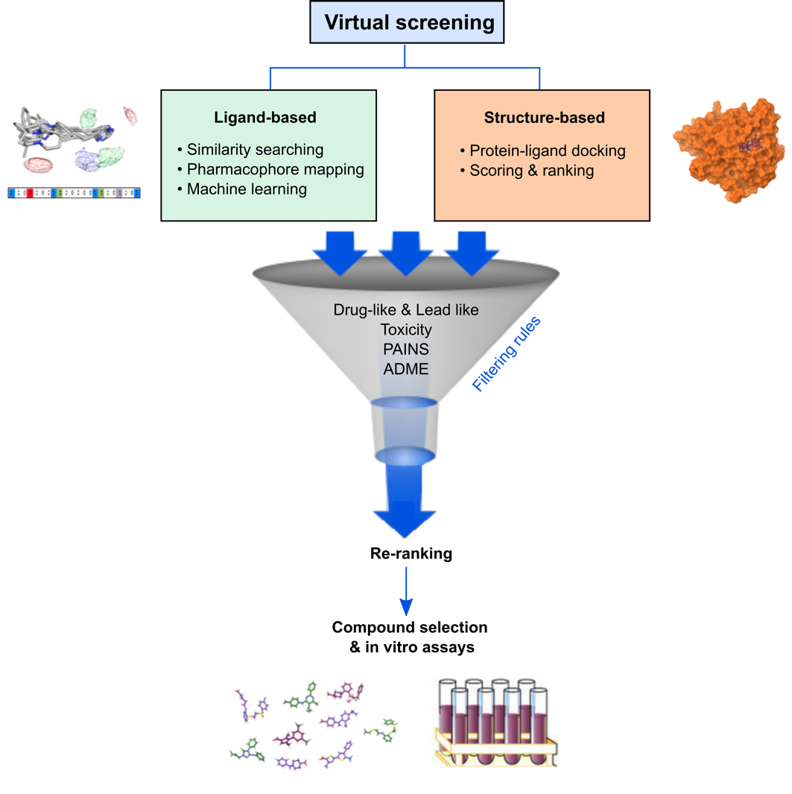

Slide 33
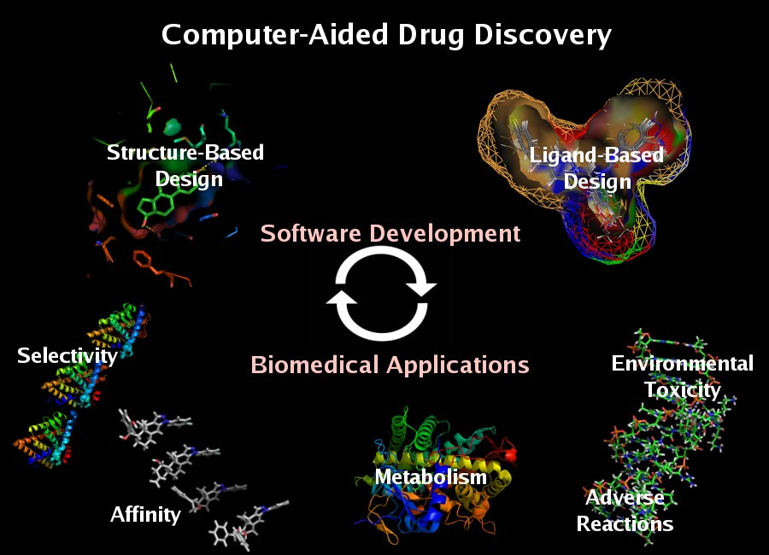

Slide 34
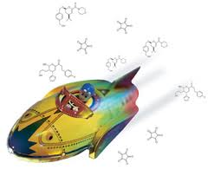
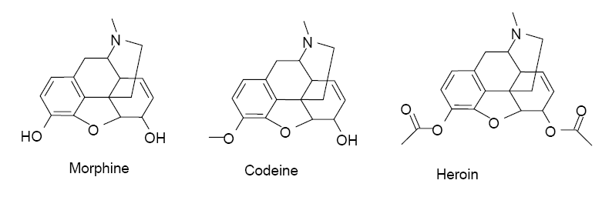
Molecular similarity on the Chemical Space
Ligand based virtual screening
Similar Property Principle – Molecules having similar structures and properties are expected to exhibit similar biological activity. (Not always true!)
Thus, molecules that are located closely together in the chemical space are often considered to be functionally related.

Slide 35
1) Ligand based virtual screening
It is based on the principle of similarity in which it is assumed that chemically similar compounds produce similar biological effects.
If one or more active chemicals are known (reference structure) against a particular target then it is possible to search a database for similar but more potent molecules
The strategy for ligand based virtual screening (LBVS) is to compute similarity between the known reference structure and each of the molecules in a database, and to rank the database molecules in decreasing order of computed similarities.

Slide 36
QSAR and Drug Design
Quantitative structure-activity relationship (QSAR) is a computational modeling method for revealing relationships between structural properties of chemical compounds and biological activities
Compounds + biological activity
QSAR
New compounds with improved biological activity

Slide 37
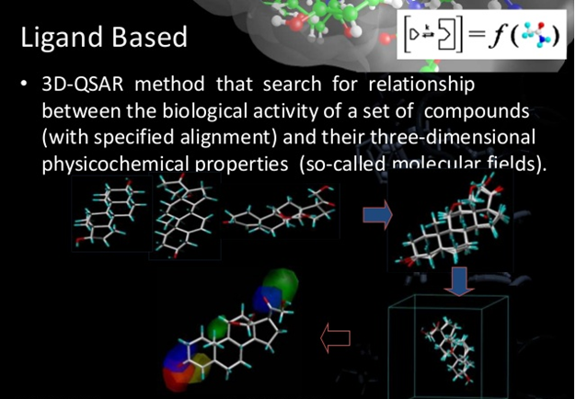

Slide 38
Ligand based VS can be carried out in two different ways.
A) Small molecule alignment
B) Descriptor-based Screening
A) Small Molecule Alignment:
The reference molecule (the compound already known to bind to the target) is
superimposed on the each of the test molecule (of the database) and the molecules
are then ranked according to the extent of their similarity.

Slide 39
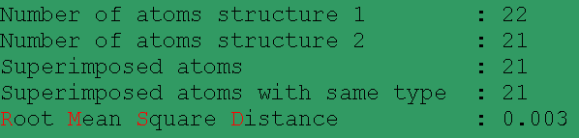
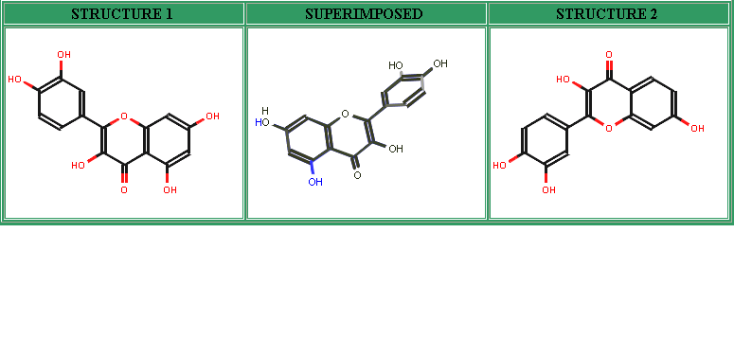

Slide 40
B) Descriptor-based screening
In the molecular alignment techniques, a single molecule comparison takes a considerable amount of time. Hence, the descriptor based approach has been introduced and proves to be more efficient in searching large chemical libraries.
The molecular descriptors are generated on the basis of different specific molecular details like conformational, topological or microscopic information. On the basis of dimensional properties descriptors can be grouped as 1D, 2D and 3D descriptors.

Slide 41
Different techniques are proposed and each method has its own advantages and disadvantages.
Among these methods, regression and classification methods such as:
Multiple Linear Regression,
Nearest Neighbors,
Naïve Bayesian Classification,
Support Vector Machines,
Neural Networks and
Decision Trees
Have been successfully applied.

Slide 42
DECISION TREES
For the present work, this latter approach of descriptor-based screening has been used. Random Forest (RF) modelling, one of the decision tree methods is used for virtual screening of an Indonesian herbal constituents database (IHD).
RF modelling provides an effective means to identify lead compounds when there is more than one compound with known activity

Slide 43
2) Structure-based virtual screening
Structure based methods are used when the 3D structure of the biological target is known, usually from X-ray crystallography or predicted by homology modeling.
Molecular Docking is the predominant technique used for structure based virtual screening (SBVS).
Docking is a fast and automated method to place the large number of available candidate compounds within the active site of target protein and then the activity of the compounds being ranked by analyzing their steric and electrostatic interactions.
In the present work, molecular docking is carried out for the IHD compounds against aldose reductase using MolDock software .

Slide 44
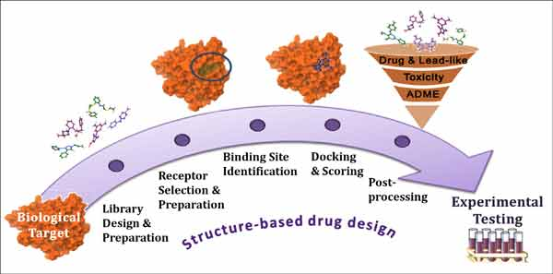

Slide 45
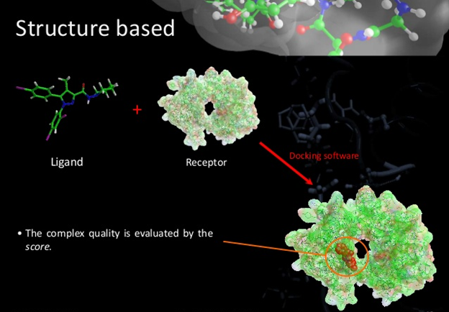

Slide 46
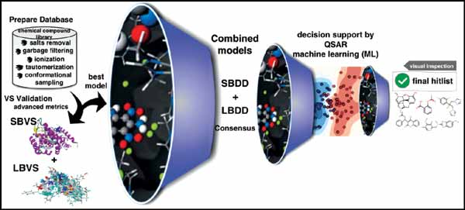

Slide 47
Ligand-based Virtual Screening
LBVS was performed by using Random Forest (RF) modelling

Slide 48
To perform LBVS (RF modeling) , a structurally diverse set of compounds already known to be active against the chosen target is required
Thus, a database of compounds with known activity against (for eg: aldose reductase (ARID) was first constructed.
It contain information on 112 plant-derived compounds active against AR
Here, LBVS has been performed by RF modeling, using two data sets,
test set ( eg. ARID)
target set (eg. IHD)
In search of compounds active against target protein (eg. AR).

Slide 49
Random Forest (RF) Modelling (STATISTICA version 9.1)
RF is one of the best known form of multiple decision trees
Predict the activity of compounds by making distinction between the active compounds and others on the basis of a set of molecular descriptors

Slide 50
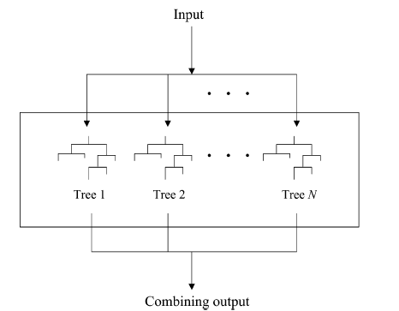
compound
Mol wt
> 300
Inactive
no
yes
No. of H
bonds
>3
Inactive
no
yes
Random Forest
Active
Decision tree

Slide 51


Slide 52
In RF modeling an ensemble of classification/decision trees is constructed to provide the activity prediction
The main object of a decision tree is to find a distinction on the basis of a set of molecular descriptors that will identify molecular features shared by different subsets of known active compounds against a particular target and accordingly filter out compounds within the target dataset in which these combinations of molecular properties are lacking.
An ensemble of decision trees (as in RF) uses the consensus voting among the trees and thus gives higher predictive accuracy.

Slide 53
Molecular Descriptors Used in RF Modeling
Three sets of molecular descriptors were calculated for each entry in both data sets
using DRAGON software
Notes:
What is RDF

Slide 54
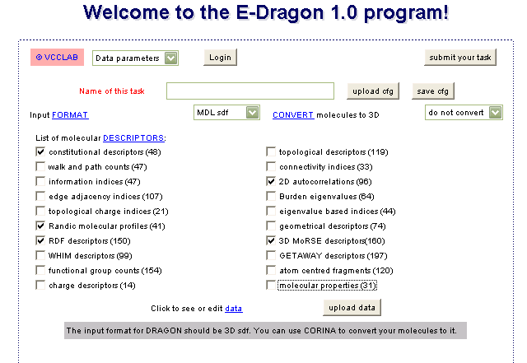

Slide 55
Constitutional Descriptors
These are the most simple and commonly used descriptors including MW, no. of
atoms (nAT), no. of bonds (nBT), no. of rings (nCIC) no. of rotatable bonds (NRB) etc.
2) Radial Distribution Function (RDF) Descriptors
It can be interpreted as the probability distribution of finding an atom in a spherical
volume of radius R.
Mainly it provide information about inter-atomic distances in the entire molecule
along with that it further provide information about bond distances, ring types, and
atom types.

Slide 56
3) Three Dimensional (3D) MoRSE Descriptors:
3D-MoRSE (3D Molecule Representation of Structure based on Electron Diffraction) descriptors are based on the idea to obtain information from the 3D atomic coordinates obtained from electron diffraction studies
Top 23 compounds predicted to be active against AR by three of the RF models and the average of the three RF scores are presented here

Slide 57
Compounds predicted as active in the RF modeling
IHD Compounds | Predicted Activity
 | Constitutional | RDF | 3DMoRSE | Average
Kumatakenin | 1.00 | 0.95 | 0.97 | 0.97
Rhamnetin | 1.00 | 0.96 | 0.96 | 0.97
Kaempferide | 1.00 | 0.94 | 0.97 | 0.97
Isoquercitrin | 0.99 | 0.95 | 0.94 | 0.96
Hyperin | 0.99 | 0.95 | 0.94 | 0.96
Quercitrin | 1.00 | 0.93 | 0.93 | 0.95
Kampferol-3-O-glucoside | 1.00 | 0.90 | 0.96 | 0.95
Astragalin | 1.00 | 0.90 | 0.96 | 0.95
Spiraeoside | 0.99 | 0.89 | 0.97 | 0.95
Prunetin | 0.99 | 0.89 | 0.94 | 0.94
Quercetin-3-glucoside | 0.99 | 0.89 | 0.92 | 0.93
Formononetin | 0.99 | 0.79 | 0.97 | 0.92
Ononin | 0.99 | 0.79 | 0.97 | 0.92
Kaempferol | 0.95 | 0.85 | 0.93 | 0.91
Isolicoflavonol | 0.93 | 0.86 | 0.94 | 0.91
Licoflavonol | 0.93 | 0.84 | 0.96 | 0.91
Licoisoflavone A | 0.93 | 0.84 | 0.96 | 0.91
Cyanidin-3-glucoside | 0.88 | 0.92 | 0.93 | 0.91
Pelargonidin-3-glucoside | 0.87 | 0.89 | 0.97 | 0.91
Isoliquiritin | 0.97 | 0.83 | 0.92 | 0.91
Glycyrrhisoflavone | 0.93 | 0.87 | 0.91 | 0.90
Neoisoliquiritin | 0.97 | 0.85 | 0.89 | 0.90
Vitexin | 1.00 | 0.82 | 0.89 | 0.90

Slide 58
Compounds were classified as active if they achieved a score of 0.50 or above in all three RF models. They were thus classified as active by ≥50% votes from the full ensemble of trees in each RF model.
Limitations:
The main limitation of the RF modeling, just as with any other similarity method, is that molecules that may be active but which are chemically distinct from the molecules included in the test set will never be picked up as hits
In-vitro studies where then performed for the selected hits obtained from RF

Slide 59
In-vitro Assay
Test Compounds | Rf Score | IC50 (µM)
Prunetin | 0.94 | 13.7
Ononin | 0.92 | 10.7
Cinnamic acid | 0.67 | 19.7
Vanillic acid | 0.63 | 36.0

Slide 60
Computer Aided Drug Design Techniques
Physicochemical Properties Calculations
Partition Coefficient (LogP), Dissociation Constant (pKa) etc.
Drug Design
Ligand Based Drug Design
QSARs
Pharmacophore Perception
Structure Based Drug Design
Docking & Scoring
de-novo drug design
Pharmacokinetic Modeling (QSPRs)
Absorption, Metabolism, Distribution and Toxicity etc.
Cheminformatics
Database Management
Similarity / Diversity Searches
All techniques joins together to form VIRTUAL SCREENING protocols

